Slide 1

SignUP API WRAPPIN UP

Slide 2


SISTEM DESIGN
Sign UP API
SignUP
Database
Azure
Event Bus
Sign Up Api is a Web API that allow Students enroll in courses. was designed with 2 endpoints for make the sign-up process, one for directly sign up and another for making asynchronous the process with. The data could be persisted in any database for this sample we use a relational database.
The API has 2 more endpoint for querying data, these 2 endpoints are cached for avoid recurrently hitting database.

Slide 3
TECHNOLOGIES AND TOOLS
Architecture DDD
NET Core 3.0 for Web API
EF Core 3.0 for data persist
Azure Event Bus for event queue Pub / Sub Pattern
Azure function queue triguered
LINQ
NewTonSoft Json

Slide 4
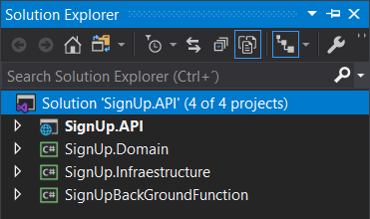
SIGN UP API
The API was designed with .NET Core 3.0. Has 3 layers, Application, Domain and Infrastructure according to the DDD principles.
The Application is a ASP.NET Core Web API project, this layer makes the interaction with the clients apps.
The Infrastructure layer persist the data in memory and later in Database.
The Domain layer has the models and business rules.
Aplication
Layer
Domain Model
Layer
Infrastructure
Layer

Slide 5
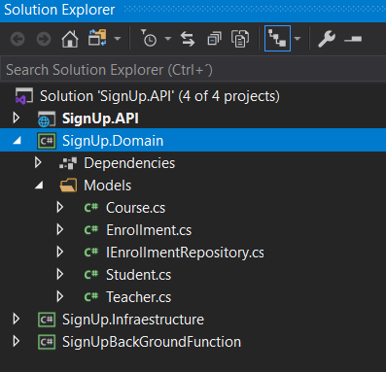
DOMAIN MODELS
Teacher
TeacherID
Name
LastName
Course
CourseID
Title
MaxParticipant
IsOpen
TeacherID
Enrollment
EnrollmentID
StudentID
CourseID
Student
StudentID
FirstName
LastName
Age
Mail

Slide 6
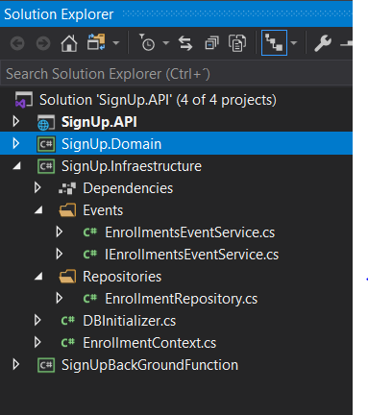
INFRASTRUCTURE LAYER
Repositories
EF Core
Enrollment Repository
EF Core 3.0
InMemoryProvider
Events
Azure EvenBus
Enrollment Event Service
Event BUS
Pub / Sub

Slide 7
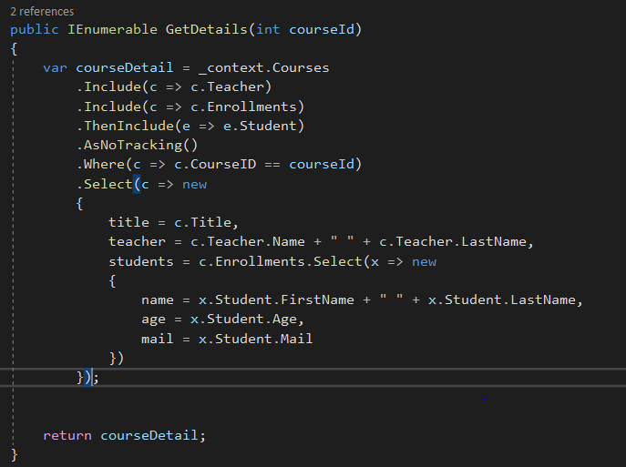
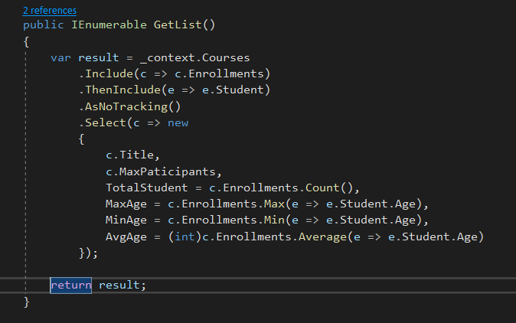
QUERIE DATA
Get Details of one especific course
Get List of Courses and Students

Slide 8
PROBLEMS AND CHALLENGES
Using Azure Event Bus and Azure Function, requires an Azure Subscription, fortunately I count with a subscription and enough credit for accomplish this
.NET Core 3.0 has some issues of compatibility with NewTonSoft JSON library, this was solved with a work around found in web forums

